Slide 1



Open Minds Club
AI School Iteration 2.3
Logistic Regression
By BOULGHERAIF Fatma Zohra
<h4>
</h4>

Slide 2

Open Minds Club
01. What is Classification?

Slide 3
Open Minds Club
01. What Is Classification?
👉 Classification = Predicting a discrete label (class) as output
Examples:
  Email Spam Filtering (Spam / Not Spam)
  Medical Diagnosis (Benign / Malignant Tumors)
  Sentiment Analysis - Classifying Social Media Posts (+ / - / neutral)
  Churn Prediction (customer will leave ("churn") or stay ("not churn"))

Slide 4
Open Minds Club
02. Binary Classification

Slide 5
Open Minds Club
02. Binary Classification
Output: y∈{0,1}
Example:
  Will this student pass? yes/no
Goal:
Learn a function that maps inputs → class label

Slide 6
Open Minds Club
02. Binary Classification as a Probability
P(y=1 | x)
Input: x ∈ ℝⁿ
Output: P(y=1 | x) ∈ [0,1]
Thresholding (seuillage in fr):
ŷ = 1 if P(y=1 | x) ≥ 0.5
ŷ = 0 otherwise
NB:
  Some models output labels directly (e.g. trees)
  Others output scores or probabilities

Slide 7
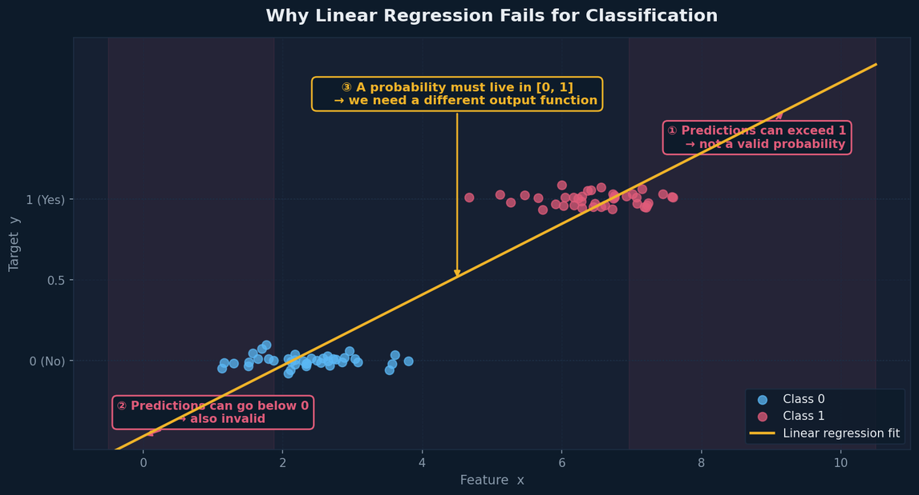
Open Minds Club
02. Why Not Linear Regression?
- Linear regression gives you outputs like `1.4`, `-0.2`, `0.87` , what do those mean?
- Nothing stops the line from predicting outside [0, 1]

Slide 8
Open Minds Club
We need to restrict the output to [0, 1]
03. The Sigmoid Function

Slide 9
Open Minds Club
03. Sigmoid
The fix: Wrap the linear equation inside a sigmoid function that maps any real number → [0, 1].
σ(z) = 1 / (1 + e⁻ᶻ) where z = β₀ + β₁x₁ + ... + βₙxₙ
X ---> h(x)
Rn ---> R
x ---> sigmoid(x)
R ---> [0, 1]
So the full model is:
P(y=1 | x) = σ(h_β(X))

Slide 10
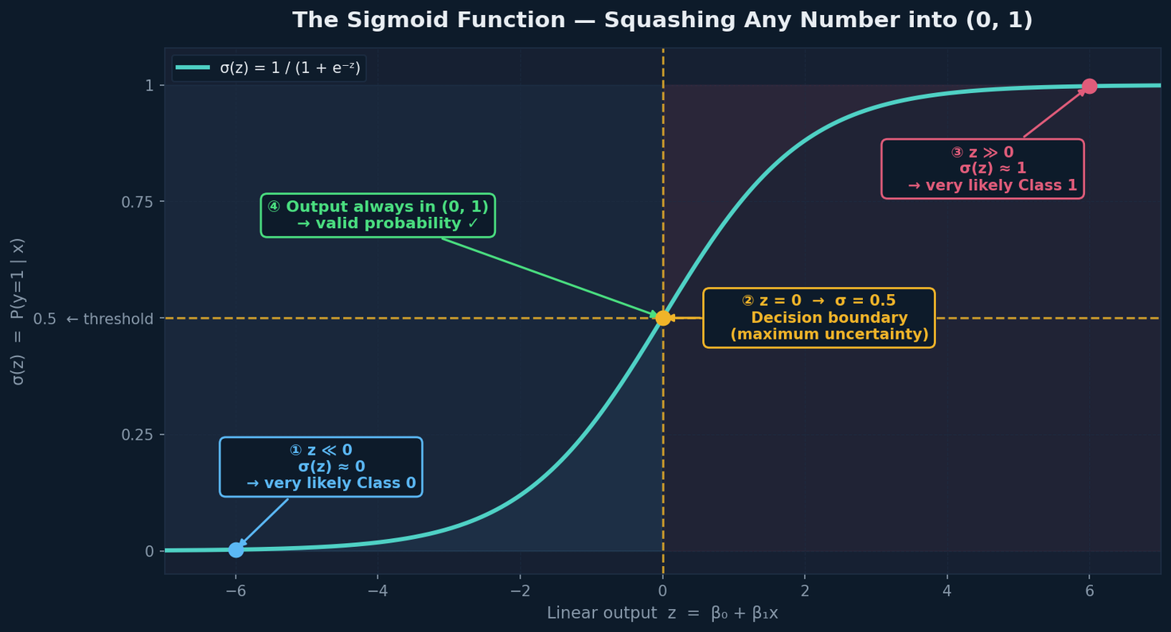
Open Minds Club
03. Sigmoid

Slide 11
Open Minds Club
03. Logistic Regression: Forward Pass
X ∈ ℝⁿ
│
│ Linear combination
▼
z = β₀ + βᵀX ∈ ℝ
│
│ Sigmoid
▼
P(y = 1 | X) = σ(z) = 1 / (1 + e^{-z}) ∈ [0, 1]
│
│ Threshold (e.g. 0.5)
▼
ŷ ∈ {0, 1}

Slide 12
Open Minds Club
04. Log Loss (Binary Cross-Entropy)

Slide 13
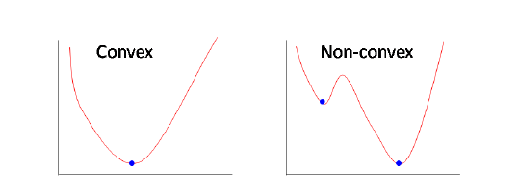
Open Minds Club
04. Log Loss (Binary Cross-Entropy)
Why not MSE?
- With sigmoid outputs, MSE creates a non-convex loss surface, gradient descent gets stuck in local minima
- MSE also doesn't penalize confident wrong predictions harshly enough

Slide 14
Open Minds Club
04. Log Loss (Binary Cross-Entropy)
L = -(1/n) Σ [ yᵢ log(ŷᵢ) + (1 - yᵢ) log(1 - ŷᵢ) ]
Intuition:
Truth | Model says | Loss
y = 1 | ŷ ≈ 1 | ≈ 0 (good)
y = 1 | ŷ ≈ 0 | → ∞ (very wrong, heavily penalized)
y = 0 | ŷ ≈ 0 | ≈ 0 (good)
y = 0 | ŷ ≈ 1 | → ∞ (very wrong, heavily penalized)

Slide 15
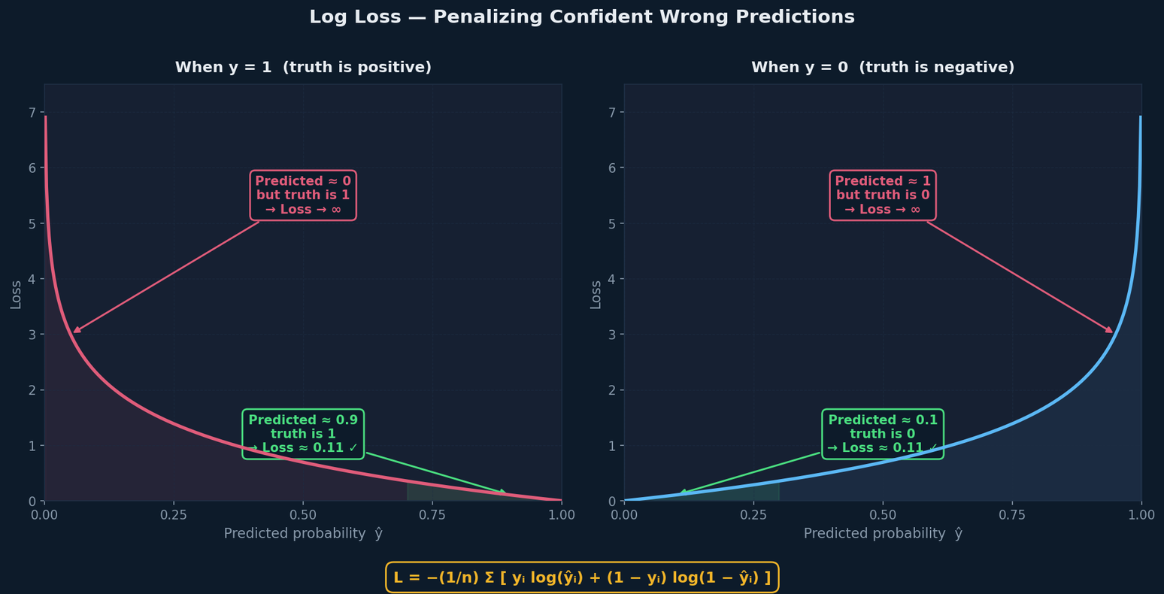
Open Minds Club
04. Log Loss (Binary Cross-Entropy)
Key property: Log loss explodes when the model is confidently wrong. It rewards calibrated, honest predictions.

Slide 16
Open Minds Club
05. Gradient Descent

Slide 17
Open Minds Club
05. Gradient Descent
Good news: You already know this part.
The update rule of the backward pass is exactly the same:
wᵢ(t+1) = wᵢ(t) − η · ∂L/∂wᵢ
- The loss changed, but the algorithm does not change.
- Gradient descent on log loss is convex → guaranteed to find the global minimum

Slide 18

Open Minds Club
Any Questions ?

Slide 19
Open Minds Club
Thank you for your attention ✨

